Slide 1
CS 2001 Python programming

Slide 2
Lecture Objectives
Introduce the concept of Object Oriented Programming
Brief the salient features of Python
Provide guidance regarding the installation of python

Slide 3
Object oriented programming
A programming concept that was developed in the modern era.
A different perspective towards real world problems that include large amount of data
The concept of structure was modified and a new datatype called class was defined.
Class can be user defined or can be built in, similar to that of function.
Within a class, there can be finite number of dissimilar datatypes
Classes will have the provision to define their own functions (methods)
Variables of a class are called instances of that class or objects of that class
There can be constructor functions within which the instance of the class can passed as
argument

Slide 4
Example for a class
int arrival(delayed_time)
{
arrival_time += delayed_time;
return arr_time;
}
int departure(delayed_time)
{ departure_time += delayed_time;
return departure_time;
}
}
class train
{
// characteristics
int train_no;
char destination;
char train_type;
int arrival_time;
int departure_time;
https://www.simplilearn.com/tutorials/cpp-tutorial/class-and-object-in-cpp

Slide 5
Features of OOPs
Data Encapsulation
Data abstraction
Polymorphism
Inheritance

Slide 6
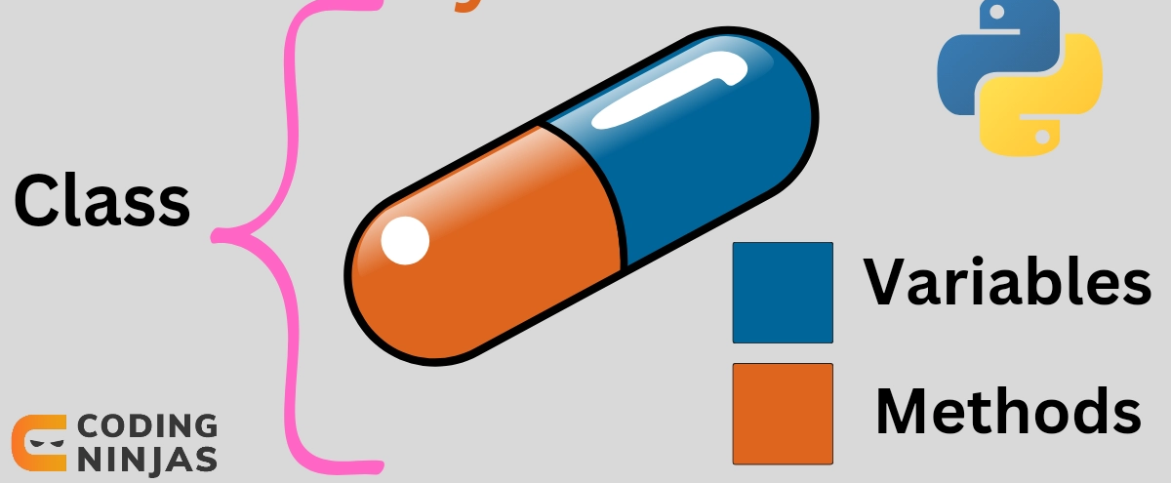
DATA Encapsulation
In object oriented programming we can define ‘class’ to bind related attributes and functions Into a single unit
All members of the class can be accessed outside the class by creating an object of that class
Binding dissimilar datatypes and functions into a single unit is called encapsulation

Slide 7
Data abstraction
Data abstraction comes along with encapsulation.
It can be called as data hiding also
Functions or variables within a class can be hidden from other part of the program.
In C++, data abstraction is done with the help pf access priority
Three types of access specifiers are used in C++- public, private and protected.
Python supports abstract class and abstract methods

Slide 8
inheritance
The literal meaning of this word is adopted to describe the property of classes
In OOPs, any class can have its derived class or subclass.
Derived class can inherit the features of the parent class.
For Example, there can be a parent class ‘Employee’ within which we can define derived classes like “Manager”, “Accountant”, “Front officer” etc.
Inheritance enables to have better codes with fewer lines.

Slide 9
polymorphism
Polymorphism implies same name- different tasks
C++ supports functional polymorphism and operator overloading
Functional polymorphism – Within a single program we can have many functions with the same name but difference in the type and number of arguments
void Area( int, int):
void Area(float, float);
void Area(int, int, int);
Operator overloading refers to the multiple use of the same operator.

Slide 10
PYTHON
High level, object oriented, programming Language
Developed by Dutch scientist Guido Van Rossum in 1991
Named after a popular TV show 'Monty Python's Flying Circus’
One of the most popular programming language of 21st century
Scripting Language ( Line by line execution)

Slide 11
Features of python
Open Source
Support of packages or libraries
Software quality
Developer productivity
Program portability
Component integration

Slide 12
Domains of application
Scientific Programming - NASA, Fermi Lab
Movie Animation - Pixar, Industrial light and magic
Financial market forecasting - JP Morgan
Hardware Testing - Qualcomm, IBM, HP
Video Sharing - YouTube
…..many more

Slide 13
Working with python
Scripting mode:
Write a complete program in an editor, save it and run
Not for beginners
Interactive mode:
Write the code line by line and execute in a python shell
Good for beginners

Slide 14
Installation of python
Go to www.python.org
Click on downloads
Choose the appropriate version
Download it and run the .exe file
tick ‘Add to the path’ dialog box and install
Go to the command window and type python –version
If the installation is complete, the version of python will be displayed

Slide 15
Installation of jupyter
Go to windows power shell ( command window)
Type pip install jupyter
Create a folder in your preferred location
Open the folder, right click, select open in terminal
Terminal with folder name as directory will appear
Type jupyter notebook
Jupyter notebook tab will be opened
https://www.youtube.com/watch?v=ClTWPoDHY_s

Slide 16
https://realpython.com/jupyter-notebook-introduction/

